Slide 1
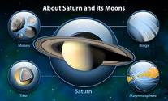
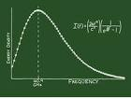
African People
In Science, Invention & Technology
Nzingha Nommo
President AfriWare Books, Co
www.afriwarebooks.com

Slide 2
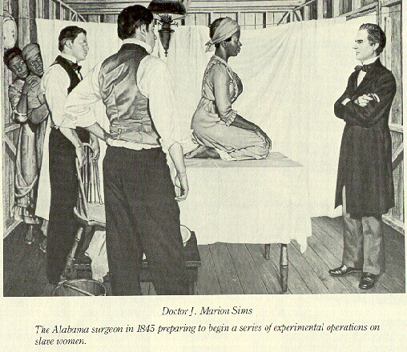
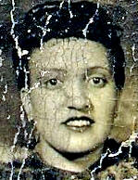
The comments for this presentation are dedicated to those who sacrificed their lives so that we may live.
Dedication to the countless who donated their bodies to Science…. involuntarily
“Medical Apartheid” – Harriet Washington
“Immortal Life of Henrietta Lacks by Rebecca Skloot

Slide 3
Check the Stats
From 1923 to 1947, 12 Blacks earned a Ph.D. in Mathematics.
1925 The first african american to earn a Ph.D. in Mathematics (Cornell University) was Elbert Frank Cox. There were 28 Ph.D.'s awarded in the United States that year. However, nearly 20 years would pass before the first african american Women would earn a Ph.D.
Less than 1% of all mathematicians are Black. 25% of these are women.
Ref: http://www.math.buffalo.edu/mad/madhist.html

Slide 4
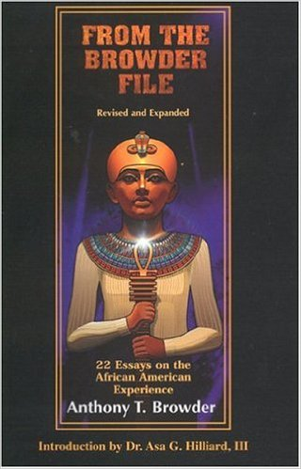
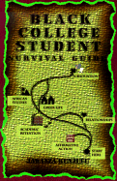
Checklist Pre-college….
Firm cultural foundation – Independent study, library, independent bookstores (Afriwarebooks.com)
Explore your hobbies/interests
Find your passion

Slide 5
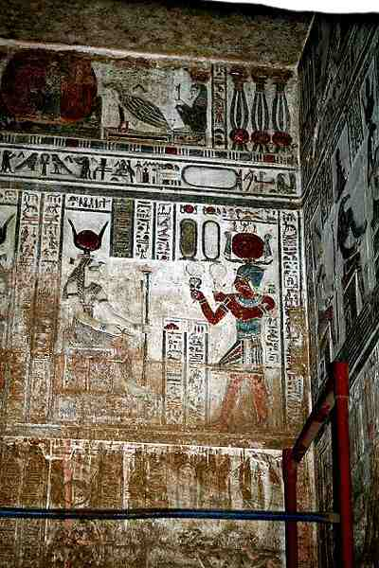
DON’T BELIEVE THE HYPE
Brochure states:
Dendara Temple is famous for it's astronomy scenes and zodiac signs on the ceilings. The Temple is of the Greek/Roman period and is the only temple to have a calendar on the ceiling.
Greek and Roman period??? No, Greek/Roman = 8/9th BC, the temple is more than 2000 BC
http://luxuryluxortrips.com/Full-Day-Dendara---Abydos.html

Slide 6
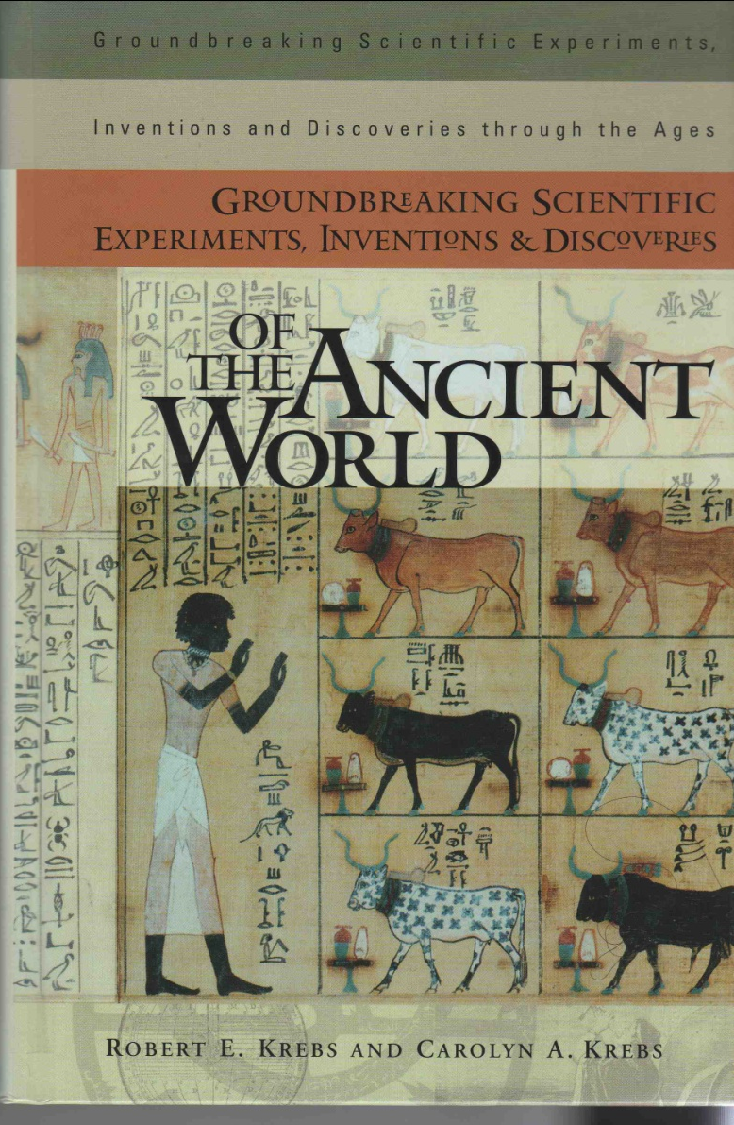
Check the Texts
Title:
Groundbreaking Scientific Experiments, Inventions & Scientific Experiments, Inventions & Discoveries of the Ancient World
By Robert E. Krebs and Carolyn A. Krebs
Copyright 2003

Slide 7
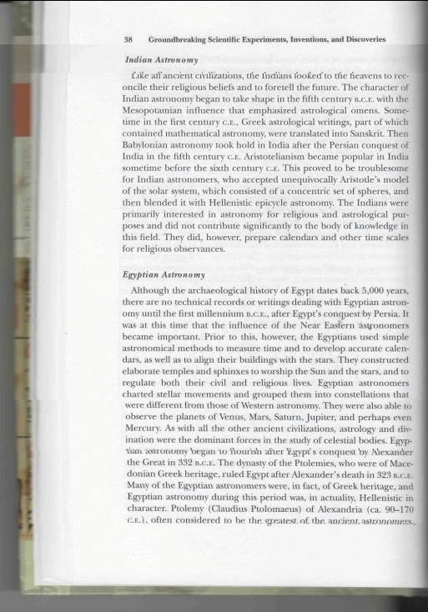
“Although the archaeological history of Egypt dates back 5,000 years, there are no technical records or writings dealing with Egyptian astronomy until the first millennium B.C.E., Egypt’s conquest by Persia. The Egyptians used simple astronomical methods to measure time and to develop accurate calendars as well as to align their buildings with the stars. …Egyptian astronomers charted …different from Western astronomers. … They were also able to observe the planets of Venus, Mars, Saturn, J upiter, and perhaps even Mercury….Egyptian astronomy began to flourish after Egypt’s conquest by Alexander the Great in 332 B.C.E. Many of the Egyptian astronomers were in fact of Greek heritage, and Egyptian astronomy during this period was, in actuality, Hellenistic in character.”
Egyptian Astronomers of Greek Heritage?

Slide 8
In College
Find the right advisor
Do all subjects well, be open to the possibility of change based on your interests
Add a minor, or double major or undecided
You are supposed to change the world
How majors can compliment each other like business, marketing
Circa 1500 BC, Rhind Mathematical Papyrus

Slide 9
What is your Passion, or how do you find it?
What are your hobbies, interests
What if you had an audience of investors waiting to hear your ideas, what would you ask them for?
What would your logo look like??
You can do it all
Ref: http://blackinventions.org/inventorslist.htm

Slide 10
What is your passion, Math??

Slide 11
Black Hall of Fame

Slide 12
Blacks in Science and Invention
Masters of Invention movie - https://www.youtube.com/watch?v=pEPT9lwpEjw

Slide 13
Black Pilots
Red Tails Trailer -https://www.youtube.com/watch?v=BpA6TC0T_Lw

Slide 14
Major Taylor – Fastest Bicycle Rider in the World
https://www.youtube.com/watch?v=zFw6FK6YmtA– Major Taylor

